Slide 1
Kristina Maricle
Senior Instructional Designer
Center For Teaching and Learning
Quick Start Guide for Instructors

Slide 2
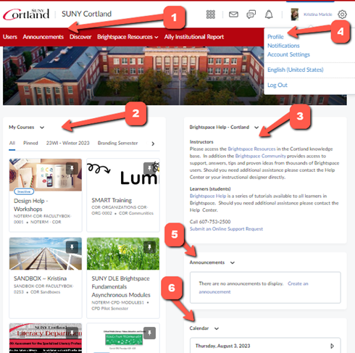
Get to know your Brightspace Dashboard
NavBar
Semester tabs
Brightspace Help – Cortland
Profile
Announcement widget
Calendar

Slide 3
Brightspace Dashboard
NavBar - The navigation bar containing useful tabs. The NavBar will look different depending on whether you are on your dashboard or in a course.

Slide 4
Brightspace Dashboard: Semester Tab
Semester tabs - Your courses are sorted by semester. You can view "All Course" in the first semester tab. Read our guide “How can I re-order my courses on the dashboard” to learn about pinning specific courses to the top.

Slide 5
Brightspace Dashboard: Help
Brightspace Help – Cortland - This is where you can access Cortland’s Brightspace Resources in our knowledge base for Faculty and students and contacting the The Help Center by phone or submitting a ticket.

Slide 6
Brightspace Dashboard - Profile
Profile - You can view and edit profile information by clicking on your name and selecting Profile, as well as uploading a photo. This is also where students will choose their notification settings.

Slide 7
Brightspace Dashboard - Announcements
Announcement widget - Important announcements from the Brightspace Support team will appear here. Be sure to check this out at different times of the semester, as new announcements are posted.

Slide 8
Brightspace Dashboard - Calendar
Calendar - Important due dates from the assignments, discussions, and quizzes will appear here if you have selected Due Dates.

Slide 9
Change your Course Image
When your course is generated in Brightspace, it is assigned a random stock image. You can choose to keep this image or change it to a new one. There are stock photos you can choose from or upload a new one.
Option One: Choosing from a stock photo
Hover Mouse over Image, click on the "three dot" menu that appears on the right side of your header image.
Choose Change Image.
Pick the image you like best and Save.
Option Two: Upload your own header image
Find an image you want to use. Keep in mind the horizontal shape of the banner and use an image that will display nicely.
Log into Brightspace and enter the course.
In the NavBar, click Course Admin
Under Site Setup, click Course Offering Information.
Click Browse under Welcome Widget Picture.
Browse your computer or drag and drop a photo. Click Add, then Save.

Slide 10
Add your Syllabus and other Content
When you enter your course, locate the NavBar (navigation bar).
Click on Content. This is where you will post all the materials your students will read, watch, or listen to and all the activities you have planned.
Syllabus - You will upload a Word document or PDF syllabus here
Table of Contents - This contains all your modules and submodules
Dragging/Reordering modules - Clicking on these dots and dragging will allow you to change the order of the modules and submodules
Hidden module - You are able to hide modules from students that you want to keep unavailable to them
Add a module - This is where you will create a new module or submodules by typing in its title, click enter. Once it's been created, you can drag/reorder it following the instructions above.

Slide 11
Review your Classlist/Roster
On your Navbar, click on "Classlist" to see all the students, instructors, and TAs enrolled in your course. This is also where you will email your entire class, by clicking the Email Classlist button.
The Classlist is automatically updated multiple times a day by synchronizing with Cortland’s Banner system. Any changes that are made in Banner will feed into Brightspace in a matter of hours. It's necessary that any students be added to your Classlist through the Registrar, who will then input the enrollment into Banner. This includes students enrolled for credit, TA's and GA’s.

Slide 12
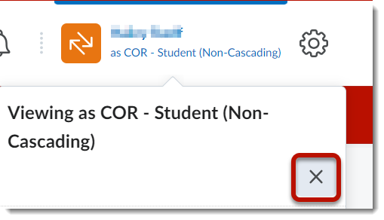
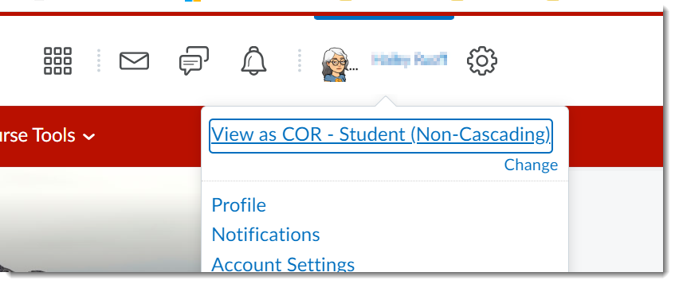
View as a Student
Brightspace allows instructors to view courses from the student view.
Note: Student View may not give an accurate preview of Quizzes, Discussions, Class Progress, or any tool where the view is specific to an individual student. It is only a general view of your course.
To exit this view, X to return to instructor view.
Click on your name at the top, right corner of the screen. Then click View as COR - Student (Non-Cascading). If you do not see this option, you are not in a course, please make sure you are in a course.

Slide 13
Activate Your Course
By default, your course will be active: and available to your students at the start of the semester. Until your course is ready, you will need to manually make the course Inactive.
Three simple steps to make your course active/inactive
Go to Course Admin -> Course Offering Information
Scroll down and check/uncheck the box Course is Active
Click Save

Slide 14
Communicate with students
Discussions KB Articles
Video Notes
Course Announcements

Slide 15
Have more Questions?
Please reach out to Design Help.
We are always glad to help!

Slide 16
End

